Slide 1
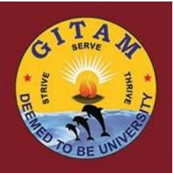
DETECTION AND TRACKING OF OBJECTS USING DRONE IMAGES
BATCH- BNUMJ_06 UNDER THE GUIDENCE OF
DEPARTMENT-CSE Dr. RUPESH KUMAR MISHRA
A.SRAVANI 221910310003
N.SOWMYA 221910310036
SAMEERA J 221910310048
S.BHARGAV KIRAN 221910310052

Slide 2
ABSTRACT
Drones, or general UAVs, equipped with cameras have been fast deployed with a wide range of applications, including agriculture, aerial photography, and surveillance. Consequently, automatic understanding of visual data collected from drones becomes highly demanding, bringing computer vision and drones more and more closely. To promote and track the developments of object detection and tracking algorithms, we have organized three challenge workshops in conjunction with ECCV 2018, ICCV 2019 and ECCV 2020, attracting more than 100 teams around the world. We provide a large-scale drone captured dataset, Vis Drone, which includes four tracks, i.e., (1) image object detection, (2) video object detection, (3) single object tracking, and (4) multi-object tracking. In this paper, we first present a thorough review of object detection and tracking datasets and benchmarks, and discuss the challenges of collecting large-scale drone-based object detection and tracking datasets with fully manual annotations.

Slide 3
INTRODUCTION
Drones lot of attention in recent years. Equipped with embedded devices, drones are able to analyze the captured data and spawn a variety of new application scenarios, e.g., Agriculture.
Drones can provide valuable insights to help farmers or ranchers optimize agriculture operations, monitor crop growth and keep herds safe, etc. Aerial photography.
Drones are used to extract aerial photography images instead of expensive cranes and helicopters , Shipping and delivery.
Drones can efficiently send packages such as medical supplies, food, or other goods to the designated places. Security and surveillance.
In this project we used the algorithm called “YOLO-V5”.

Slide 4
Why YOLO-V5?
YOLO-v5 is a real-time object detection system that utilizes deep learning algorithms
It detects and classifies the objects in images and videos with high accuracy and speed.
YOLO-v5 has a significantly smaller model size, faster inference speed, and improved accuracy compared to YOLO-V3

Slide 5
EXISTING SYSTEM
It is necessary to develop and evaluate new vision algorithms for drone captured visual data. However, as pointed out in [2], [5], studies toward this goal are seriously limited by the lack of publicly available large-scale benchmarks or datasets. Some recent efforts [2], [5], [6] have been devoted to construct datasets captured by drones focusing on object detection or tracking. These datasets are still limited in size and scenarios covered, due to the difficulties in data collection and annotation. Thorough evaluations of existing or newly developed algorithms remain an open problem. A more general and comprehensive benchmark is desired for further boosting video analysis research on drone platforms.
Disadvantages:
These datasets are still limited in size and scenarios covered, due to the difficulties in data collection and annotation

Slide 6
PROPOSED SYSTEM
This paper focuses on analyzing various representative object detection and tracking algorithms thoroughly. Specifically, we discuss and analyze the advantages and disadvantages of the submitted methods in terms of model design and training strategies. After that, we advocate several future research directions of object detection and tracking on drone-captured videos. We expect such comprehensive review and analysis to largely boost the research and development in video analysis on drones.
Advantages:
Provides a comprehensive evaluation platform for object detection and tracking.
Effectiveness and efficiency are both important aspects for algorithms in real applications.

Slide 7
REQUIRMENTS
SOFTWARE REQUIREMENTS:
Visual Studio Community Version
Node Js ( Version 12.3.1)
Python IDEL ( Python 3.7 )
HARDWARE REQUIREMENTS :
Operating System : Windows Only
Processor : i5 and above
Ram : 4gb and above
Hard Disk : 50 GB

Slide 8
MODULES
Data exploration: using this module we will load data into system
Processing: Using the module we will read data for processing
Data augmentation: using this module to artificially increase the amount of data by generating new data points from existing data.
Model generation: Building the model in colab - YOLOV5, Faster RCNN ,DRNN ,
Retina Net - Cascaded RCNN – Mask RCNN. Algorithms accuracy calculated.
User signup & login: Using this module will get registration and login
User input: Using this module will give input for prediction
Prediction: final predicted displayed

Slide 9
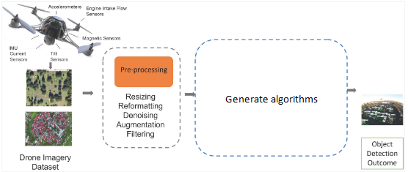
METHODOLOGY

Slide 10
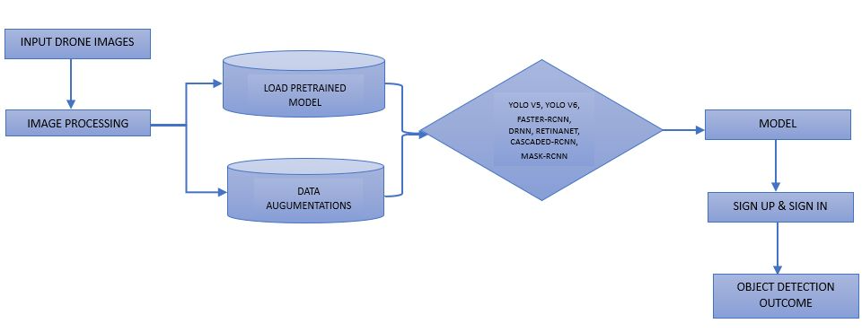
SYSTEM ARCHITECTURE

Slide 11
ALGORITHMS
YOLOV5: It is a novel convolutional neural network (CNN) that detects objects in real-time with great accuracy.
Faster RCNN: Faster R-CNN is a single-stage model that is trained end-to-end. It uses a novel region proposal network (RPN) for generating region proposals, which save time compared to traditional algorithms like Selective Search
DRNN: Recurrent neural networks (RNNs) are the state of the art algorithm for sequential data and are used by Apple's Siri and Google's voice search.
Retina Net: Retina Net is one of the best one-stage object detection models that has proven to work well with dense and small scale objects.
Cascaded RCNN: Cascade R-CNN is an object detection architecture that seeks to address problems with degrading performance with increased IoU thresholds (due to overfitting during training and inference-time mismatch between IoUs for which detector is optimal and the inputs).
Mask RCNN: Mask R-CNN is a state of the art model for instance segmentation, developed on top of Faster R-CNN.

Slide 12
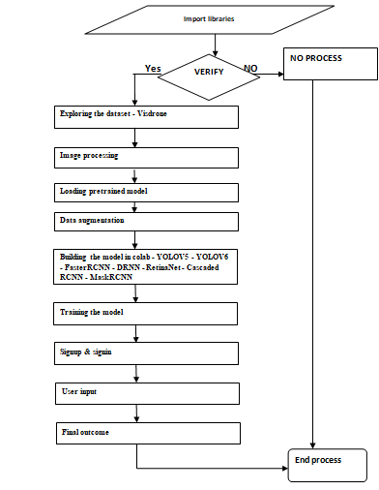
DATAFLOW DIAGRAM

Slide 13
RESULTS

Slide 14


Slide 15


Slide 16


Slide 17
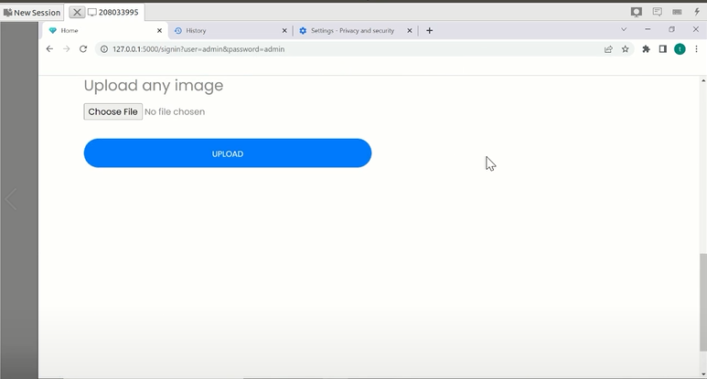

Slide 18
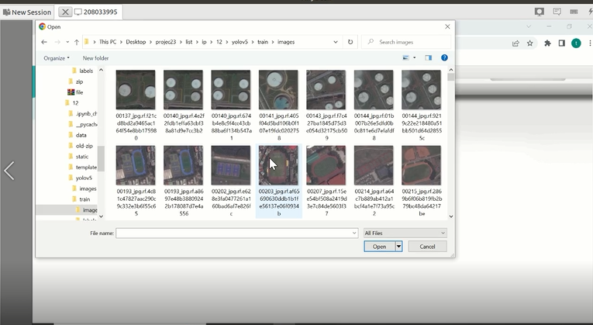

Slide 19
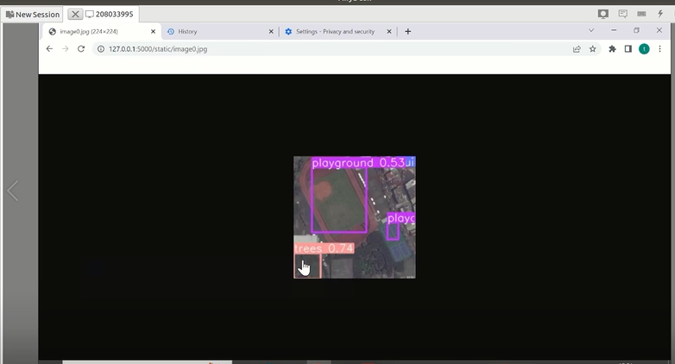

Slide 20
CONCLUSION
We introduce a new large-scale benchmark, VisDrone, to facilitate the research of object detection and tracking on drone captured imagery. With over 6,000 worker hours, a vast collection of object instances are gathered, annotated, and organized to drive the advancement of object detection and tracking algorithms.

Slide 21
REFERENCES
[1] G. V. Research, “Commercial drone market size, share & trends analysis report by product (fixed-wing, rotary blade, hybrid), by application, by end-use, by region, and segment forecasts, 2021 - 2028,” https://www.reportlinker.com/p06068219/?utm source=GNW, 2021.
[2] M. Mueller, N. Smith, and B. Ghanem, “A benchmark and simulator for UAV tracking,” in ECCV, 2016, pp. 445–461.
[3] I. Kalra, M. Singh, S. Nagpal, R. Singh, M. Vatsa, and P. B. Sujit, “Drone surf: Benchmark dataset for drone-based face recognition,” in FG, 2019, pp. 1–7.
[4] D. Du, Y. Qi, H. Yu, Y. Yang, K. Duan, G. Li, W. Zhang, Q. Huang, and Q. Tian, “The unmanned aerial vehicle benchmark: Object detection and tracking,” in ECCV, 2018, pp. 375–391.
[5] M. Hsieh, Y. Lin, and W. H. Hsu, “Drone-based object counting by spatially regularized regional proposal network,” in ICCV, 2017.

